Slide 1
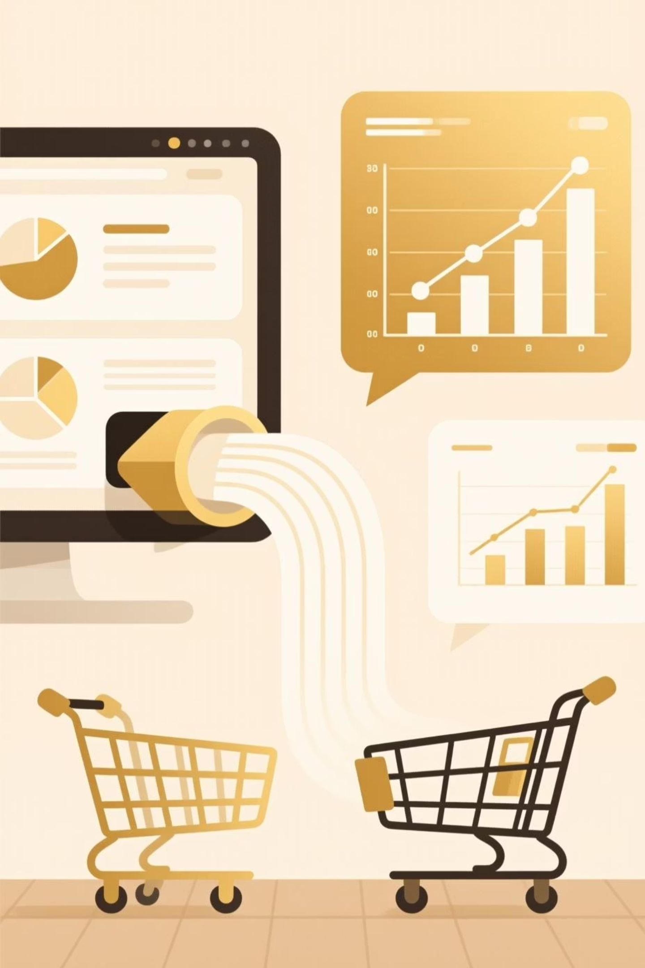
Customer Shopping Behavior Analysis
Uncovering insights from 3,900 purchases to guide strategic business decisions.

Slide 2
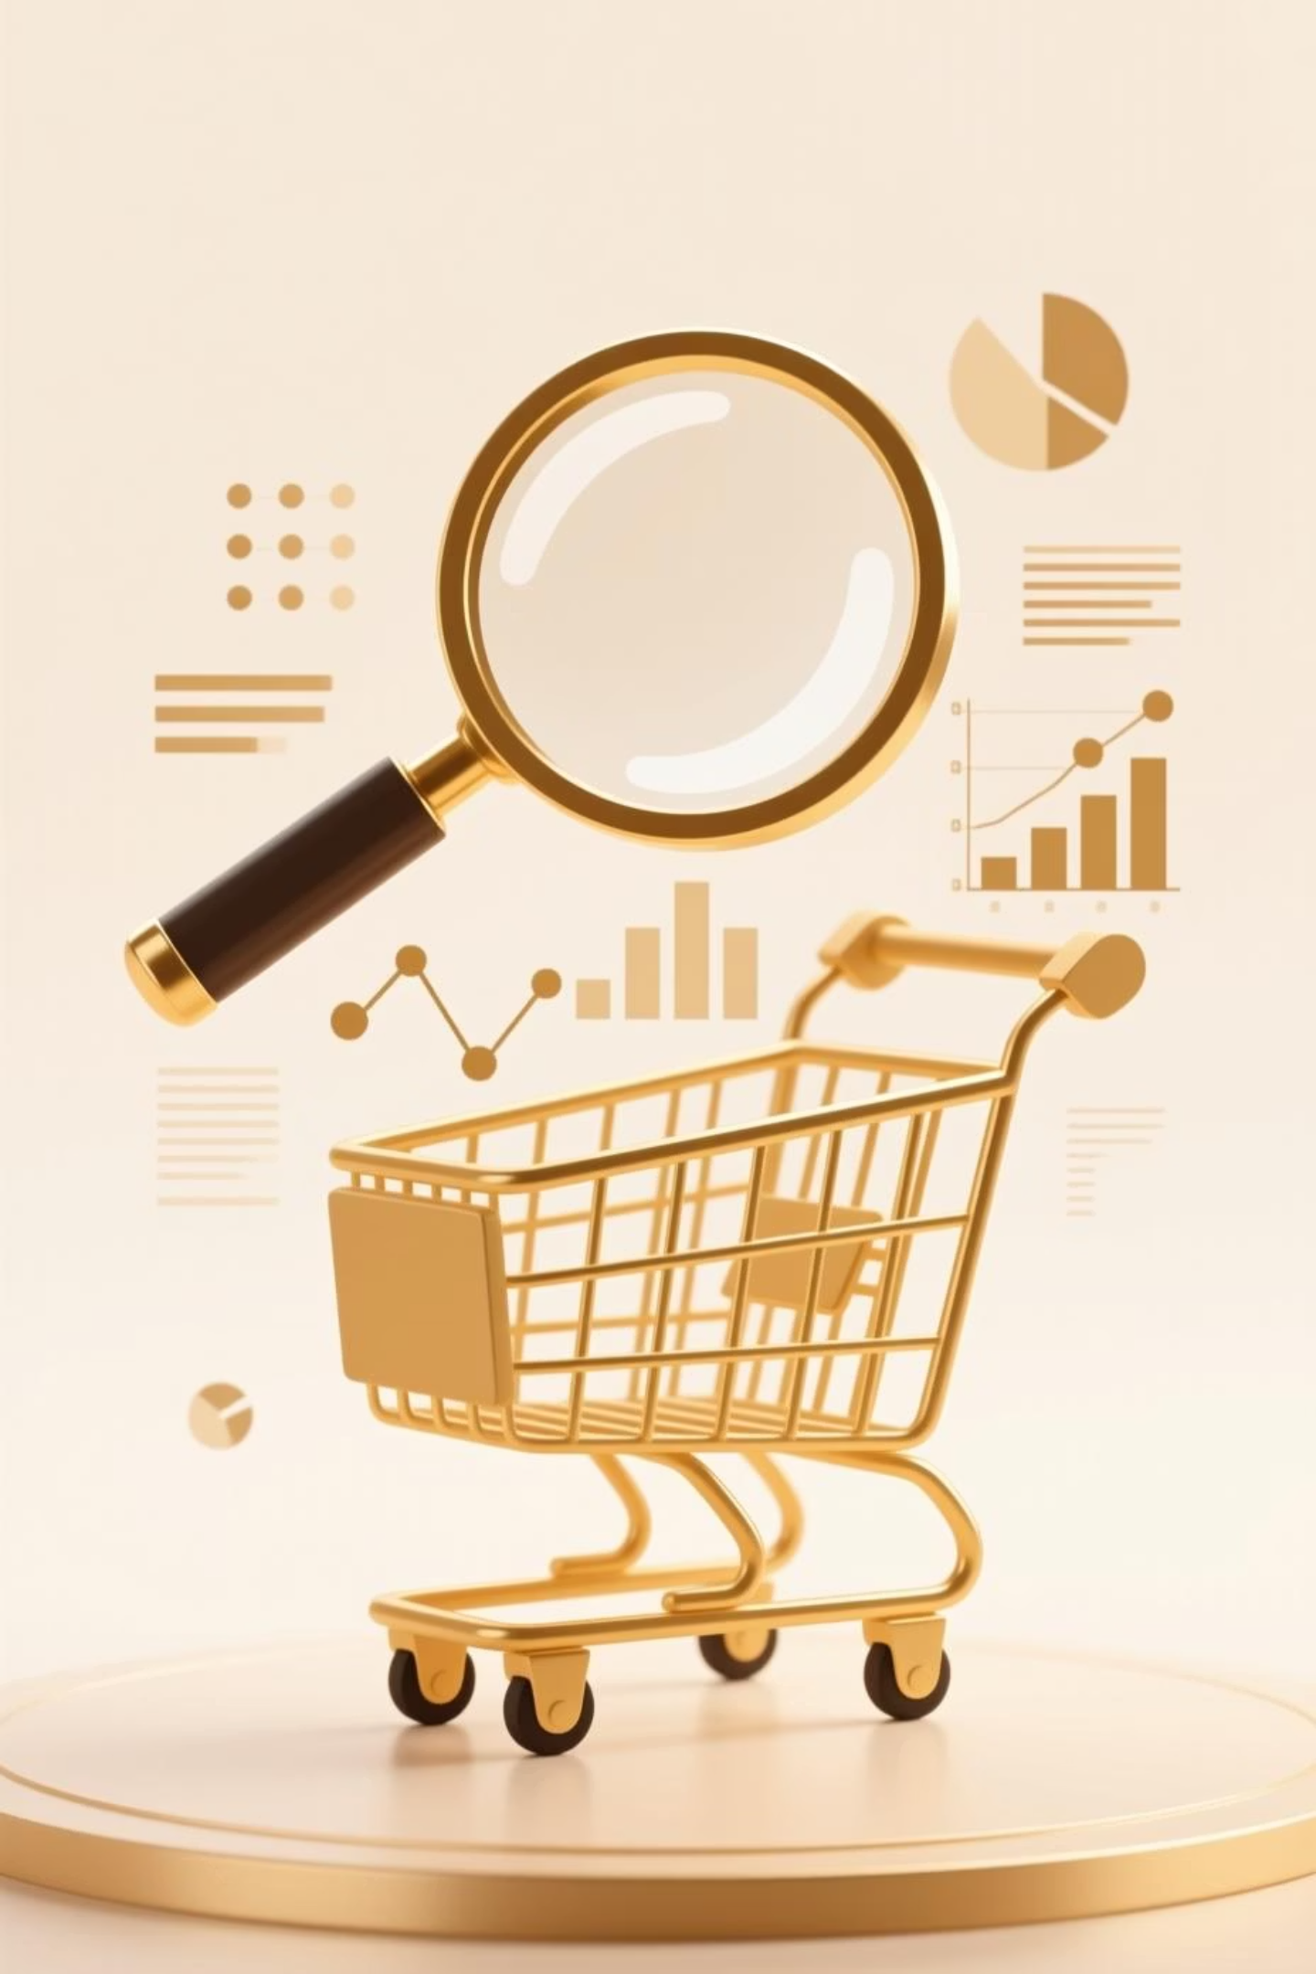
Project Overview
Goal
Data Source
Analyze spending patterns, segments, preferences, and subscriptions.
Transactional data from 3,900 purchases across categories.
Objective
Optimize operations, reduce costs, and improve forecasting.

Slide 3
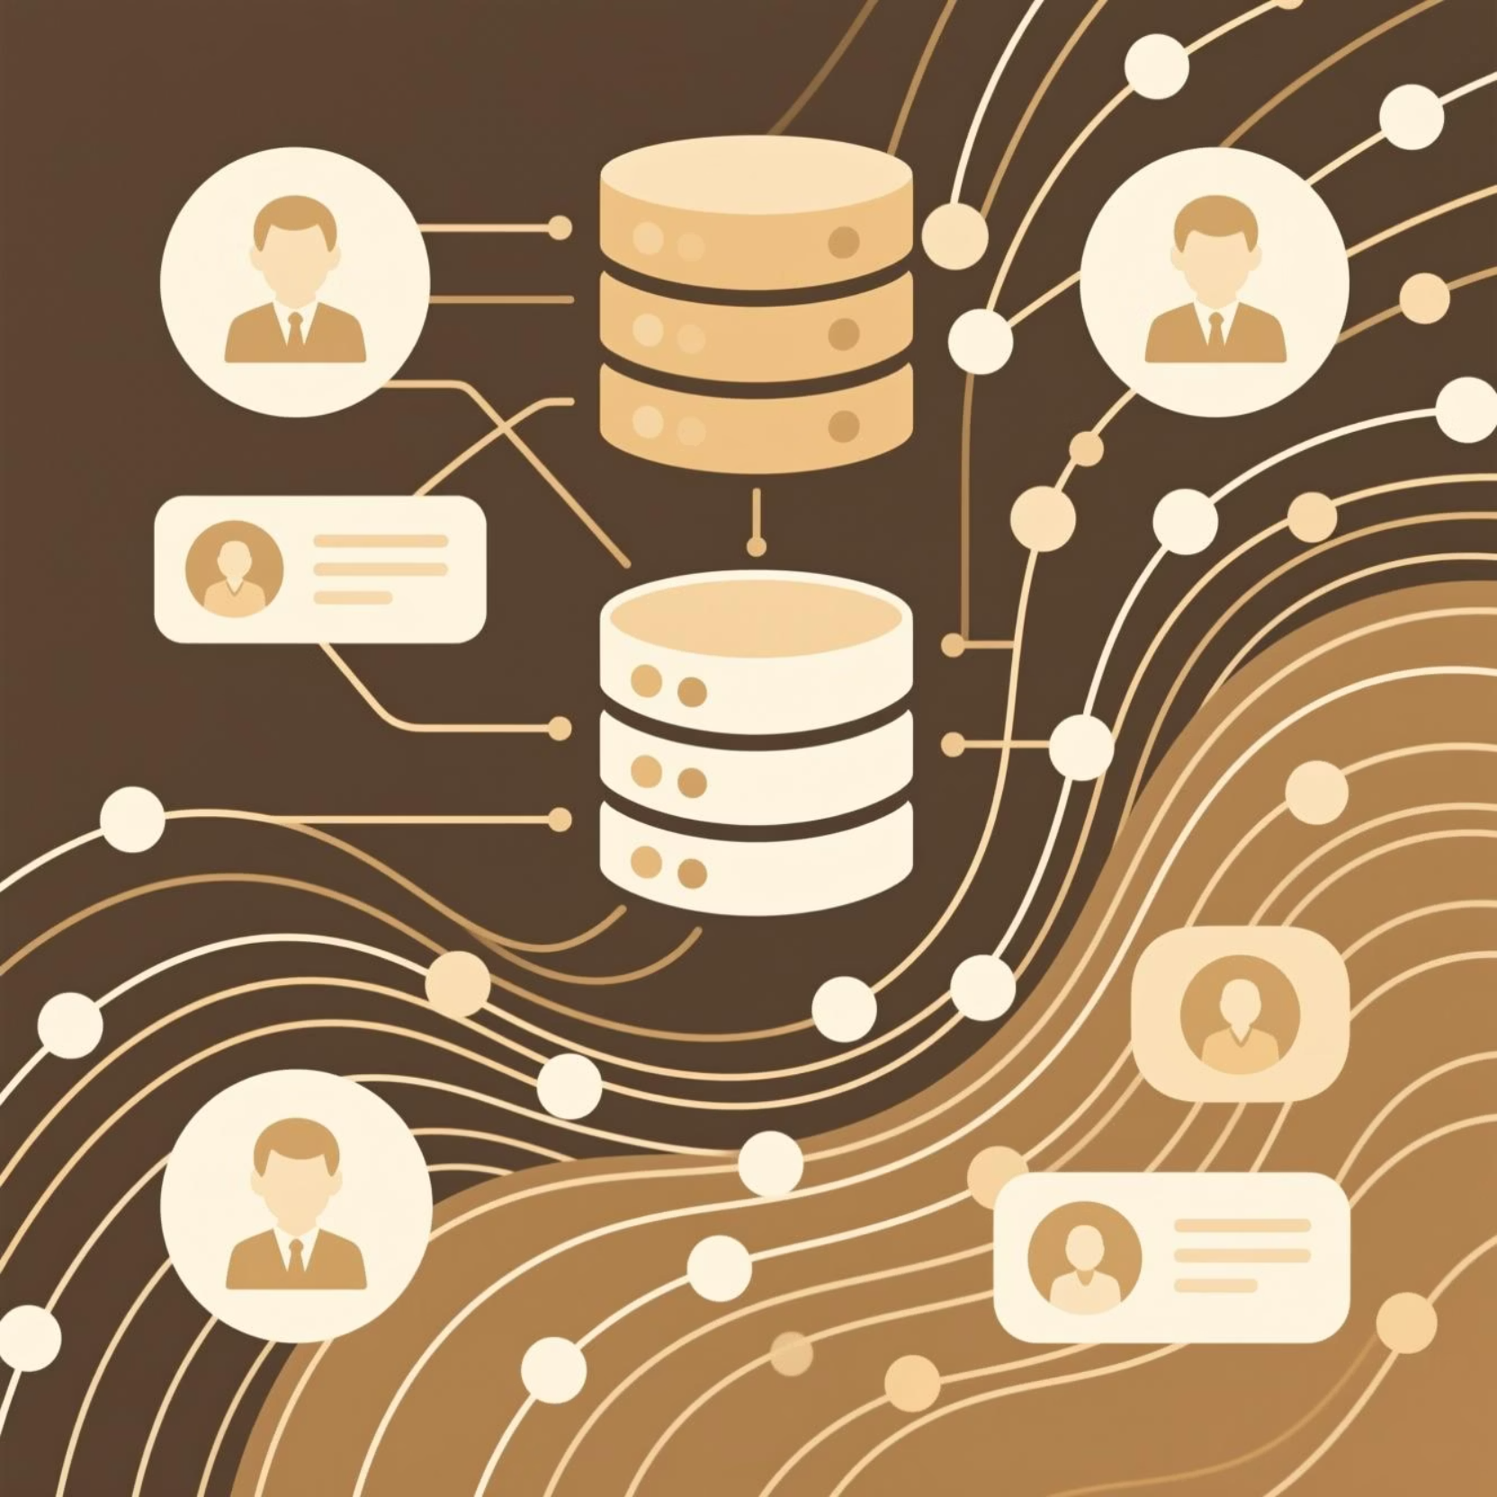
Dataset Summary: Key Features
Customer demographics (Age, Gender, Location, Subscription)
Purchase details (Item, Category, Amount, Season, Size, Color)
Shopping behavior (Discount, Promo, Previous Purchases, Frequency, Review, Shipping)

Slide 4
Data Preparation & Cleaning in Python
01
02
03
Data Loading & Exploration
Missing Data Handling
Column Standardization
Imported dataset, checked structure and summary statistics.
Imputed 37 missing 'Review Rating' values using median.
Renamed columns to snake_case for readability.
04
05
Feature Engineering
Database Integration
Created 'age_group' and 'purchase_frequency_days'.
Loaded cleaned data into PostgreSQL for SQL analysis.

Slide 5
Data Analysis: Key SQL Insights
1
2
Revenue by Gender
High-Spending Discount Users
Male customers generated significantly more revenue.
Identified customers using discounts but spending above average.
3
4
Top 5 Products by Rating
Shipping Type Comparison
Gloves, Sandals, Boots, Hat, Skirt had highest average ratings.
Express shipping users had higher average purchase amounts.

Slide 6
SQL Insights: Subscription & Discounts
62645
Discount-Dependent Products
Subscribers Total Revenue
1
Hat, Sneakers, Coat, Sweater, Pants had highest discount rates.
1053 subscribers, avg spend $59.49
170436
Repeat Buyers & Subscriptions
Non-Subscribers Total Revenue
2
Customers with >5 purchases are more likely to subscribe.
2847 non-subscribers, avg spend $59.87

Slide 7

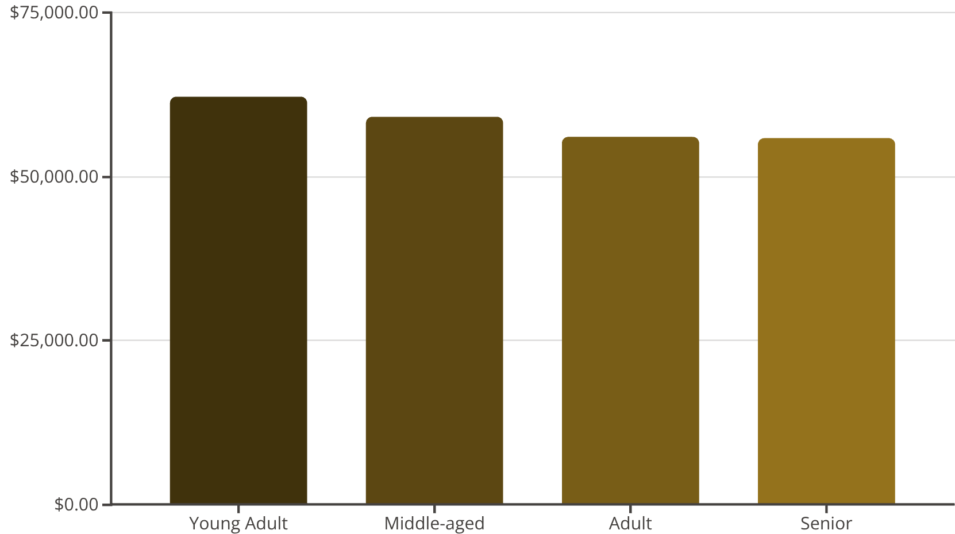

Customer Segmentation & Age Group Revenue
1
2
3
1
New
83 Customers
2
Returning
701 Customers
3
Loyal
3116 Customers

Slide 8
Top Products Per Category
Rank
Category
Item Purchased
Total Orders
1
Accessories
Jewelry
171
1
Clothing
Blouse
171
1
Footwear
Sandals
160
1
Outerwear
Jacket
163

Slide 9
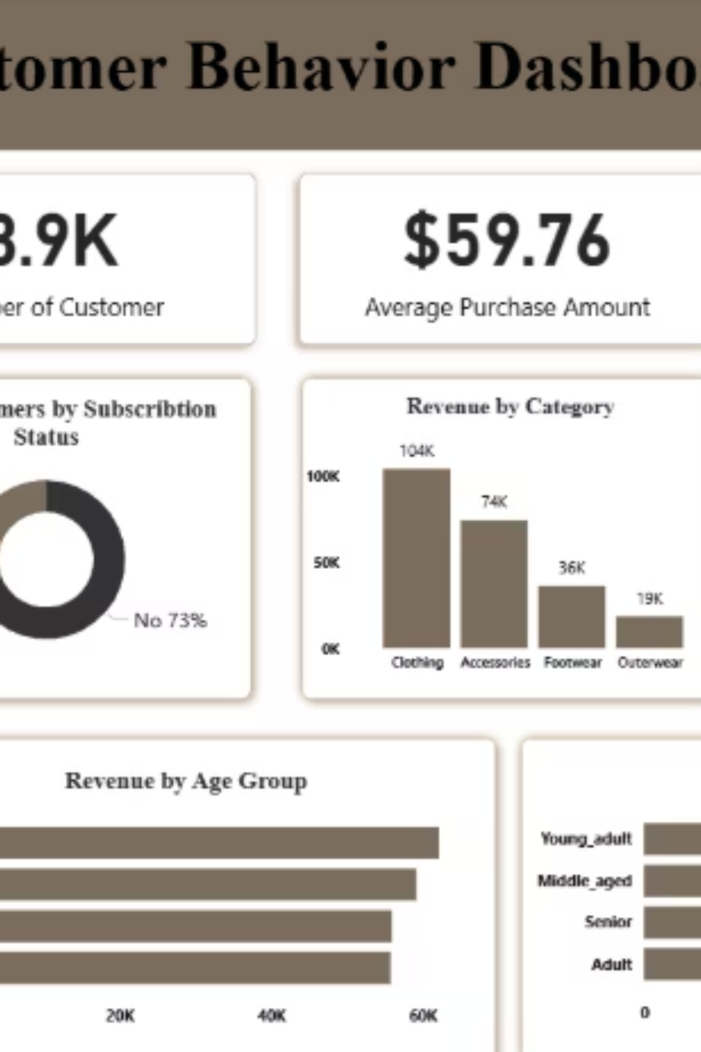
Interactive Dashboard in Power BI
Visualizing key insights for actionable business strategies.

Slide 10

Business Recommendations
Boost Subscriptions
Promote exclusive benefits to increase subscriber base.
Customer Loyalty Programs
Reward repeat buyers to foster loyalty and move them to "Loyal" segment.
Review Discount Policy
Balance sales boosts with margin control for profitability.
Product Positioning
Highlight top-rated and best-selling products in marketing campaigns.
Targeted Marketing
Focus efforts on high-revenue age groups and express-shipping users.

